Slide 1
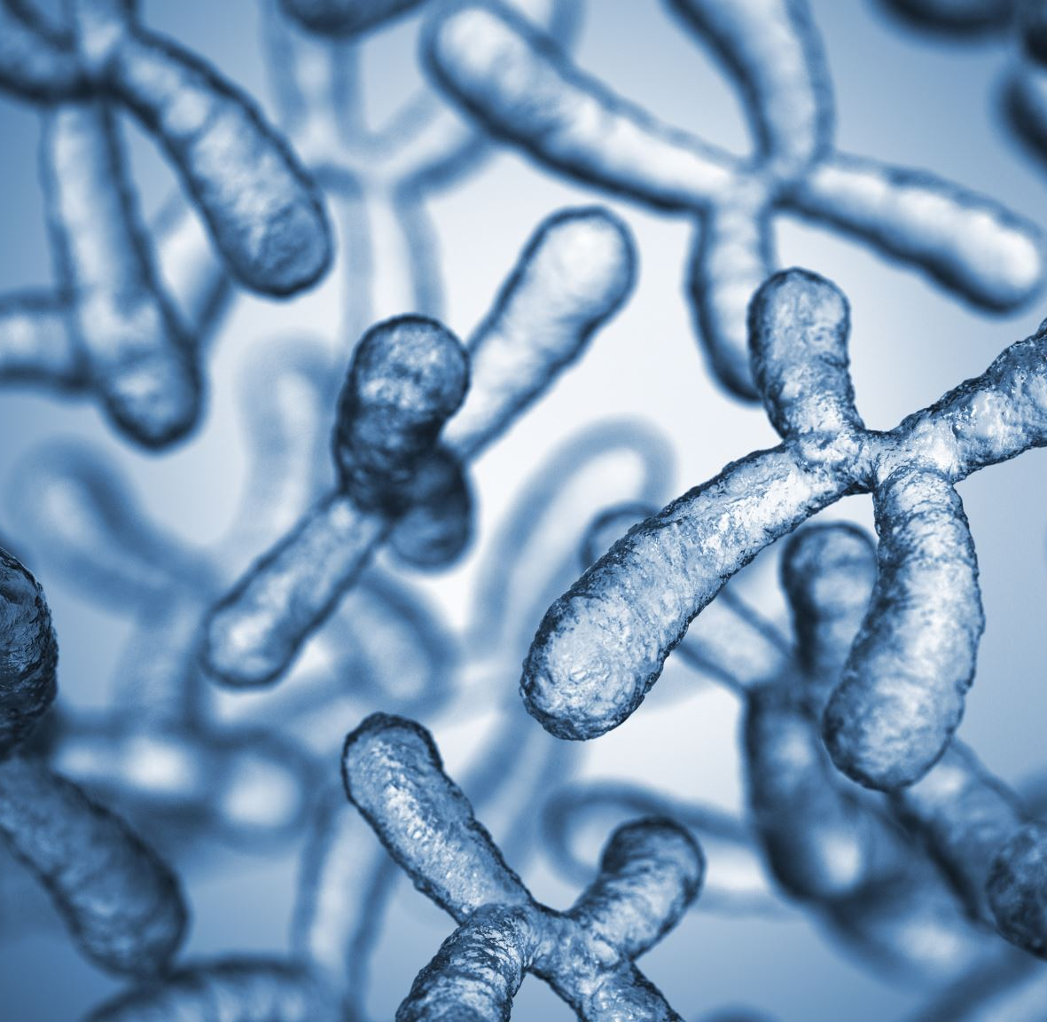
Variation in Human Chromosomes
Isaac McPadden

Slide 2
Project Goal
Examine variants on chromosomes to see which chromosomes have more changes
Determine severity of changes for each chromosome

Slide 3
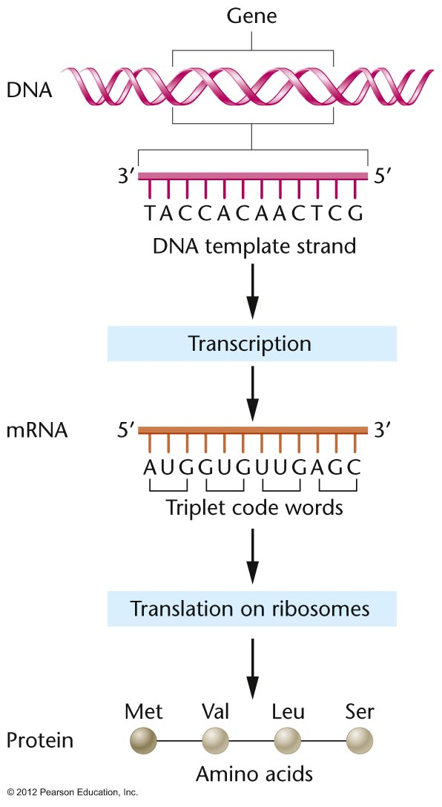
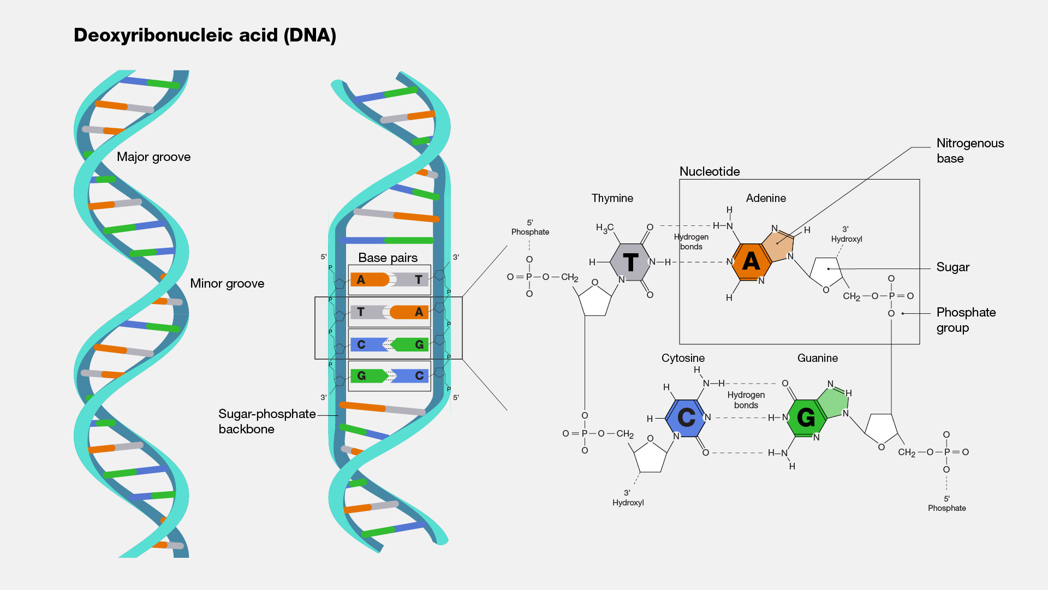
Biochemistry Primer

Slide 4
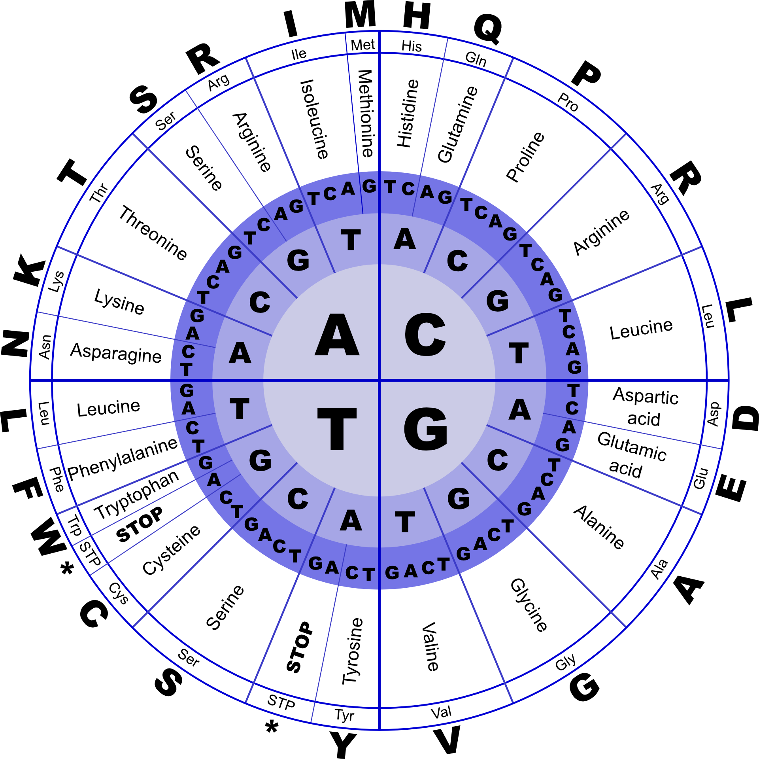
Biochemistry Primer
Each trio of base pairs (called a codon) codes for an amino acid
There are 64 possible codons but only 20 amino acids so there is a lot of redundancy
There are 3 stop codons
The codon for Methionine doubles as a start codon

Slide 5
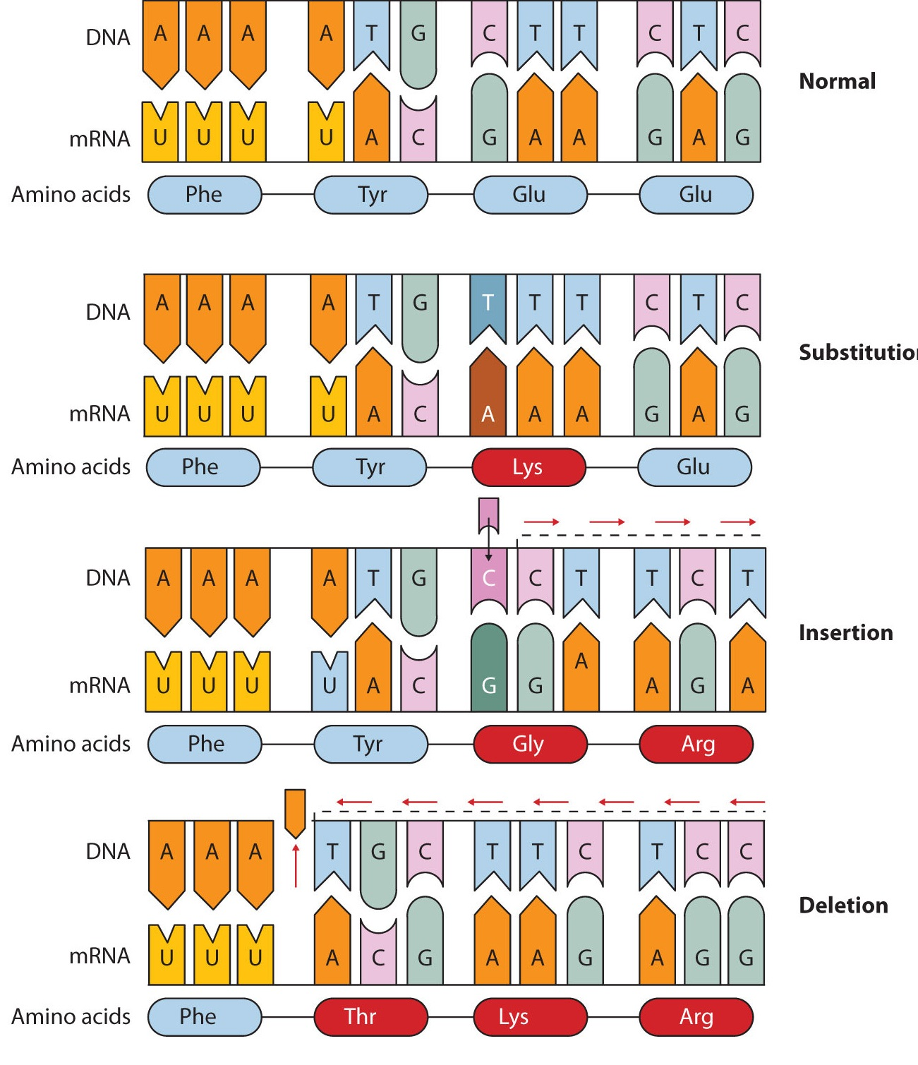
Biochemistry Primer
There are a few types of mutations
Substitution is a single base switch
Insertions and deletions (referred to as indels) can be caused by one or more base being inserted and deleted
Indels cause frame shifts which can cause major changes to the gene’s protein.
Different sequences of the same genes are called variants

Slide 6
The Data
I used 1000 Genomes (https://www.internationalgenome.org/) genetic variation data
The 1000 Genomes data are built around the Human Genome Project (HGP) reference genome.
The current version of the HGP reference genome is GrCh38 which stands for “Genome Reference Consortium Human Build 38”
The reference genome is 3.1 GB of G’s, A’s, T’s, and C’s
There is also a ton of annotation data about what the DNA is coding for. That can be dozens of GBs added on top.
Sequencing companies usually only track differences from the reference genome to keep data volume down

Slide 7
The Data
The 1000 genomes has a data set that lists variants of genes from DNA sequenced from people all over the planet
That dataset is called “1000 Genomes 30x on GRCh38” on their website
The annotated variants result in 24 text files that sum to almost 60 GB, one for each of 22 numbered chromosomes and the X and Y chromosomes
I also made a CSV from the Human Genome Project site listing how many base pairs each chromosome has (https://www.ncbi.nlm.nih.gov/assembly/GCF_000001405.40/#/st_Primary-Assembly)

Slide 8
Data Cleanup Summary
Split the text files into 1 million lines each
Dropped annotation columns that were not useful for my purposes
Used command line to merge the text files into CSVs
That gave me 24 CSVs ranging in size from 200 MB to 1.1 GB except the Y chromosome CSV which is only 19 MB

Slide 9
Data Processing
Each chromosome CSV was loaded into a Pandas Data Frame and then I ran a value count on each column
The value counts were then added to a dictionary
All that was then saved to a pickle file

Slide 10
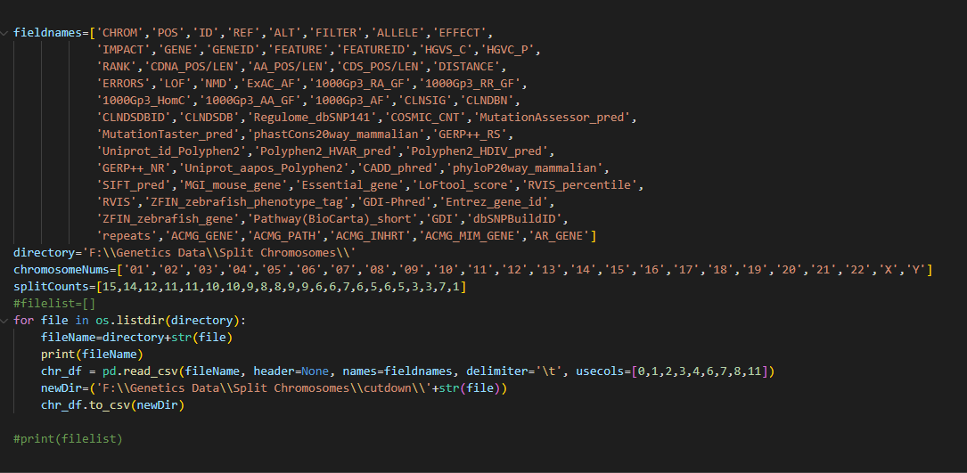

Slide 11
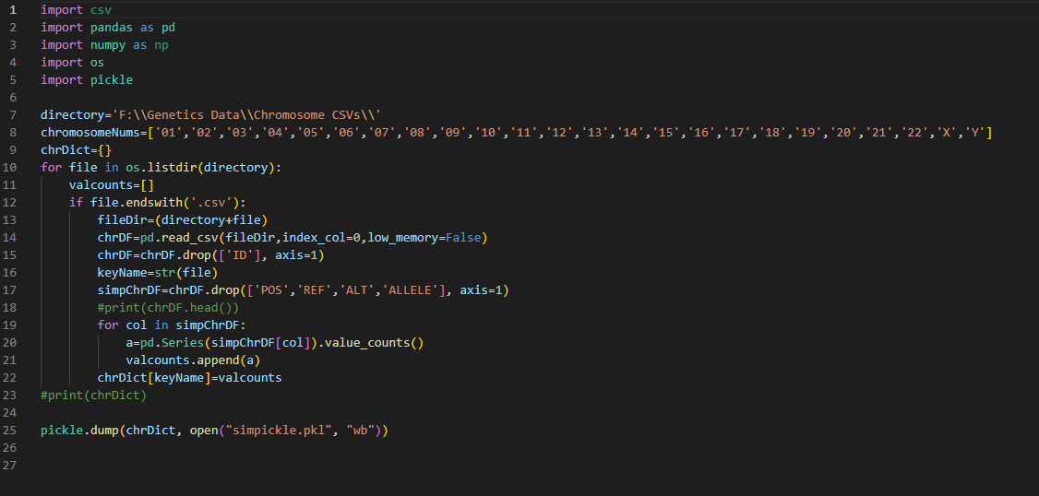

Slide 12
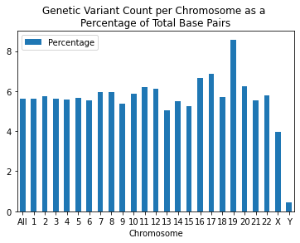
Results and Observations
Chromosome 19 experiences the most genetic variation
Most are close to 6 percent
The X and Y chromosomes are significantly lower
Especially the Y chromosome, likely because it is so much smaller than the other chromosomes that there is no room for variance
I have data for variant types, locations, and effects but have not crunched the numbers yet.
It could be that chromosome 19 has an inordinate number of variants in non-coding regions

Slide 13

According to the human genome project, 41% of human DNA is GC pairs and 59% is AT pairs.
So I made a wordcloud

